Slide 1

Book Ordering System An Innovative Online Bookstore Solution Presented By: Rohan Rashid Student ID: 21222203050 Course: CSE 328 Intake: 41-1 (DH) Date: 09-12-24

Slide 2

BANGLADESH UNIVERSITY OF BUSINESS & TECHNOLOGY (BUBT)
Participants Are: Dept. Of CSE
Name of Students | ID | Intake
Md Imran Hossen | 21222203001 | 41-01
Rajesh Chandra Barman | 21222203002 | 41-01
Istiak Ahmed Arnob | 21222203028 | 41-01
Bikash Chandra Ray | 21222203045 | 41-01
Rohan Rashid | 21222203050 | 41-01
Under Supervision of:
Ms. Meher Afroj
Assistant Professor,
Department of Computer Science & Engineering, Bangladesh University of Business and Technology (BUBT).

Slide 3
Our Agenda
INTRODUCTION 4
PROBLEM STATEMENT 5
OBJECTIVES 6
TECHNOLOGY STACK 7
SYSTEM ARCHITECTURE 8-13
FUNCTIONAL FEATURES 14
SYSTEM DESIGN 15-17
OBSERVATIONS AND LIMITATIONS 18
FUTURE ENHANCEMENT 19
CONCLUSION 20
REFERENCES 21

Slide 4

Introduction
What is the Book Ordering System?
A software application to simplify book ordering processes for customers and administrators.
Purpose of the Project:
Provide a seamless and efficient platform for book search, ordering, and inventory management.

Slide 5
Problem Statement
Challenges with Traditional Systems:
Inaccurate inventory management.
Limited customer service availability.
Lack of accessibility outside physical store hours.
Need for Automation:
A digital solution that offers 24/7 availability and efficient order processing.

Slide 6
Objectives
Primary Goals:
Enable customers to search, browse, and order books online.
Allow administrators to manage book inventory and track orders.
Key Features:
Secure user authentication and account management.
User-friendly interface for quick browsing and ordering.
Inventory management for administrators.

Slide 7
Technology Stack
Frontend:
HTML5, CSS3, JavaScript, Bootstrap.
Backend:
PHP
Database:
MySQL.
Hosting:
Localhost or Cloud-Based Servers.

Slide 8
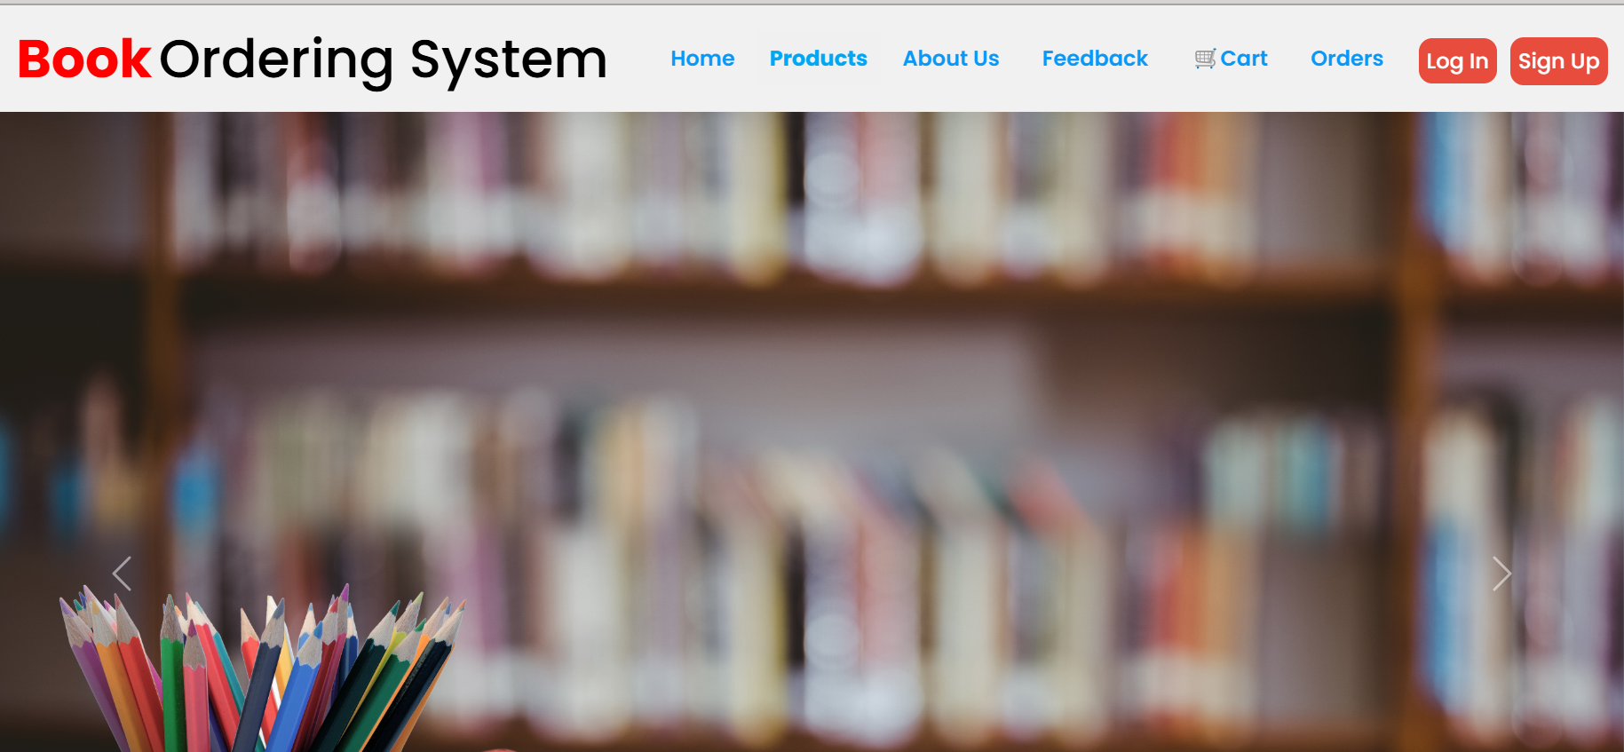
System Architecture
User Module: Registration, login, and profile management.
System Home Page

Slide 9
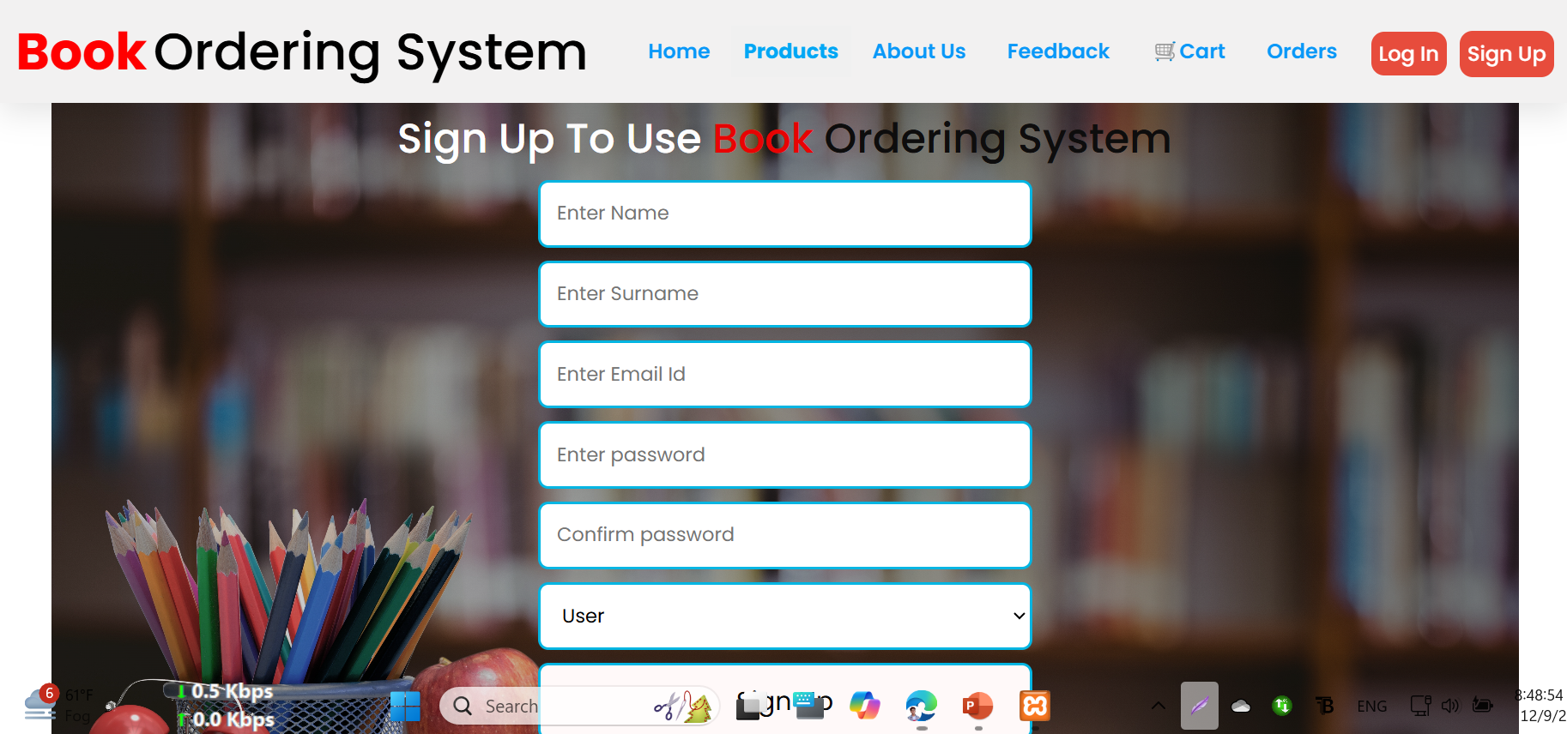
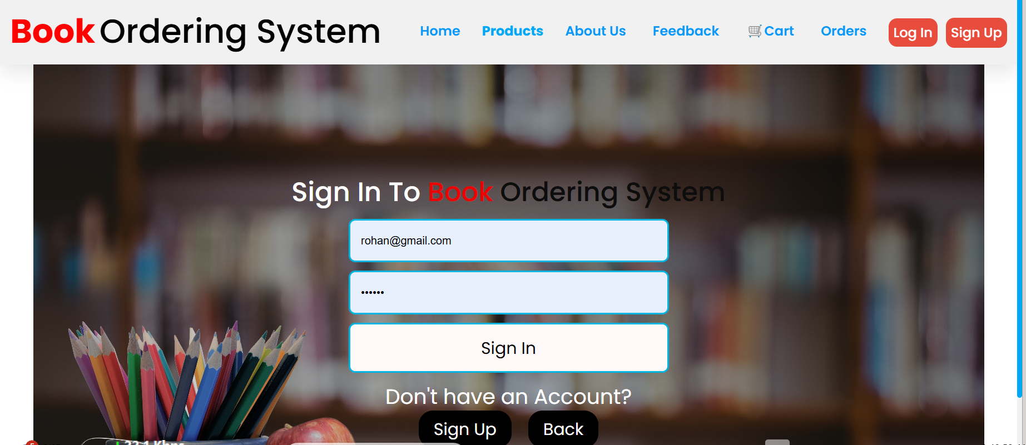
System Architecture
User Module: Registration, login, and profile management.
Registration & Log in Page

Slide 10
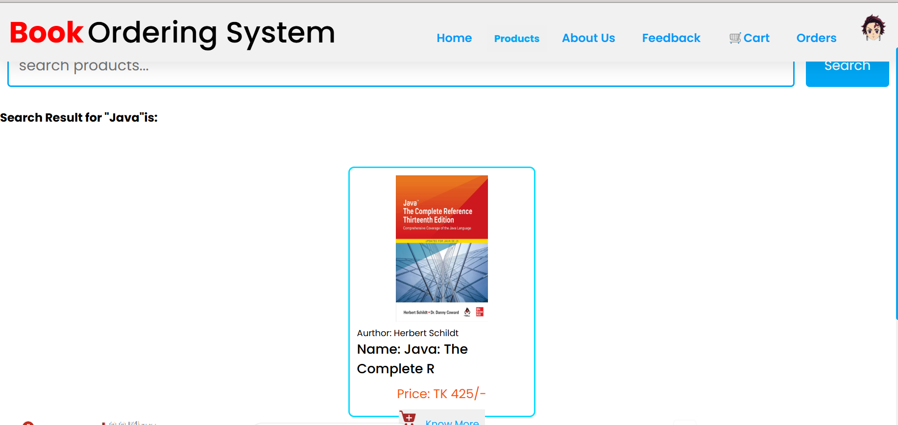
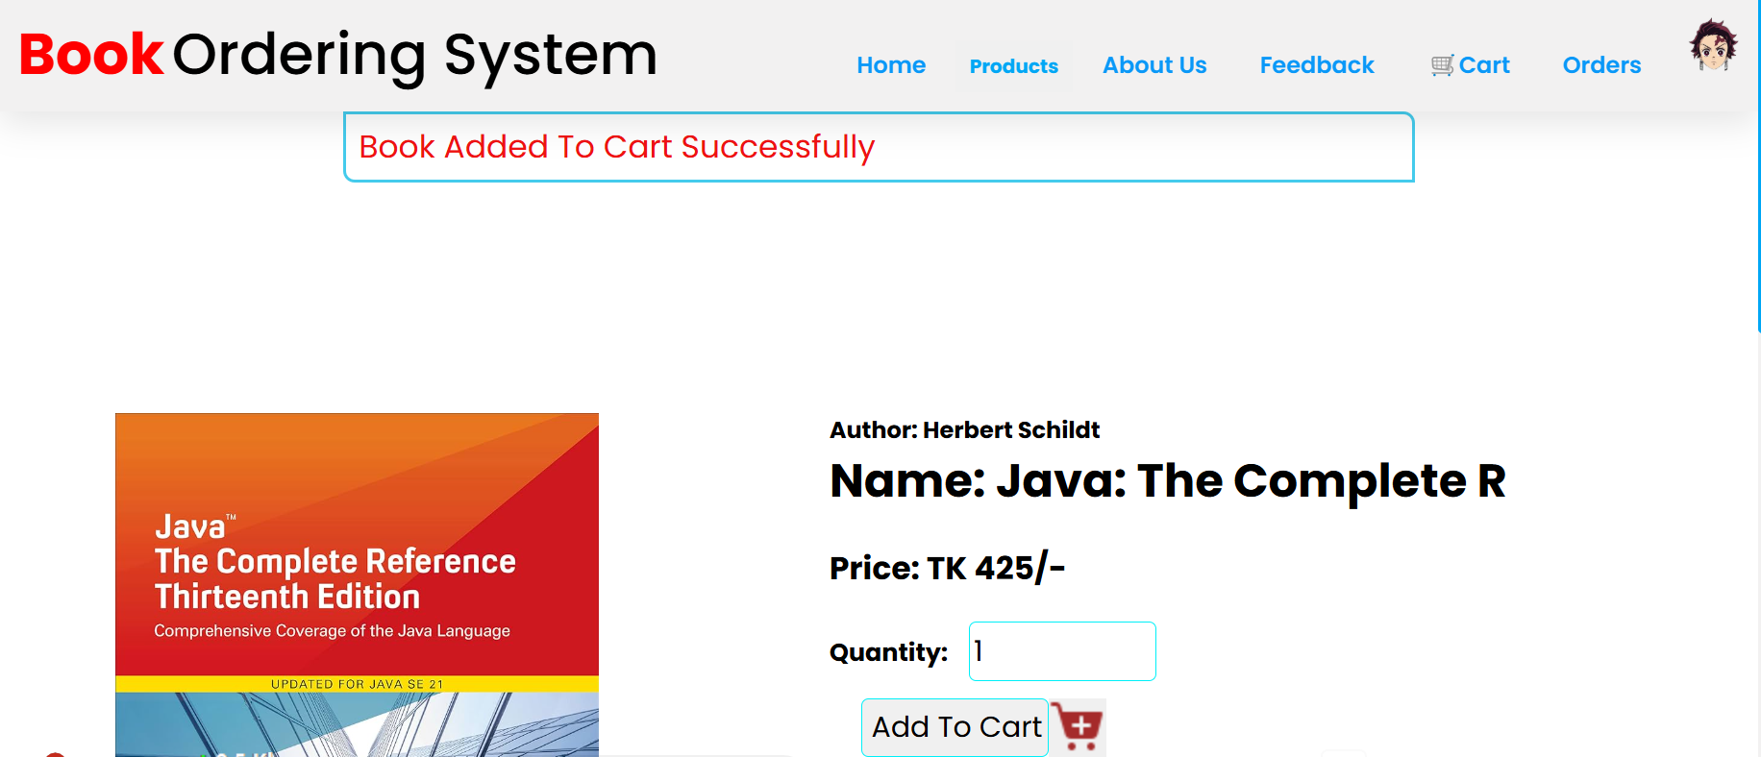
System Architecture
Book Module: Search, browse, and add to cart.
Searching a Book named ‘Java’ and added to the cart for Order

Slide 11
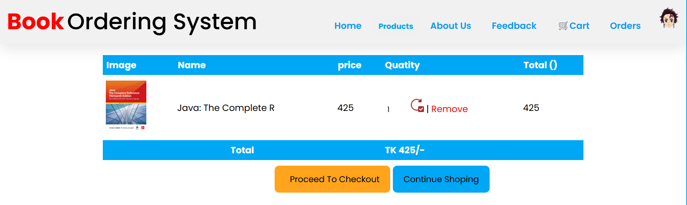
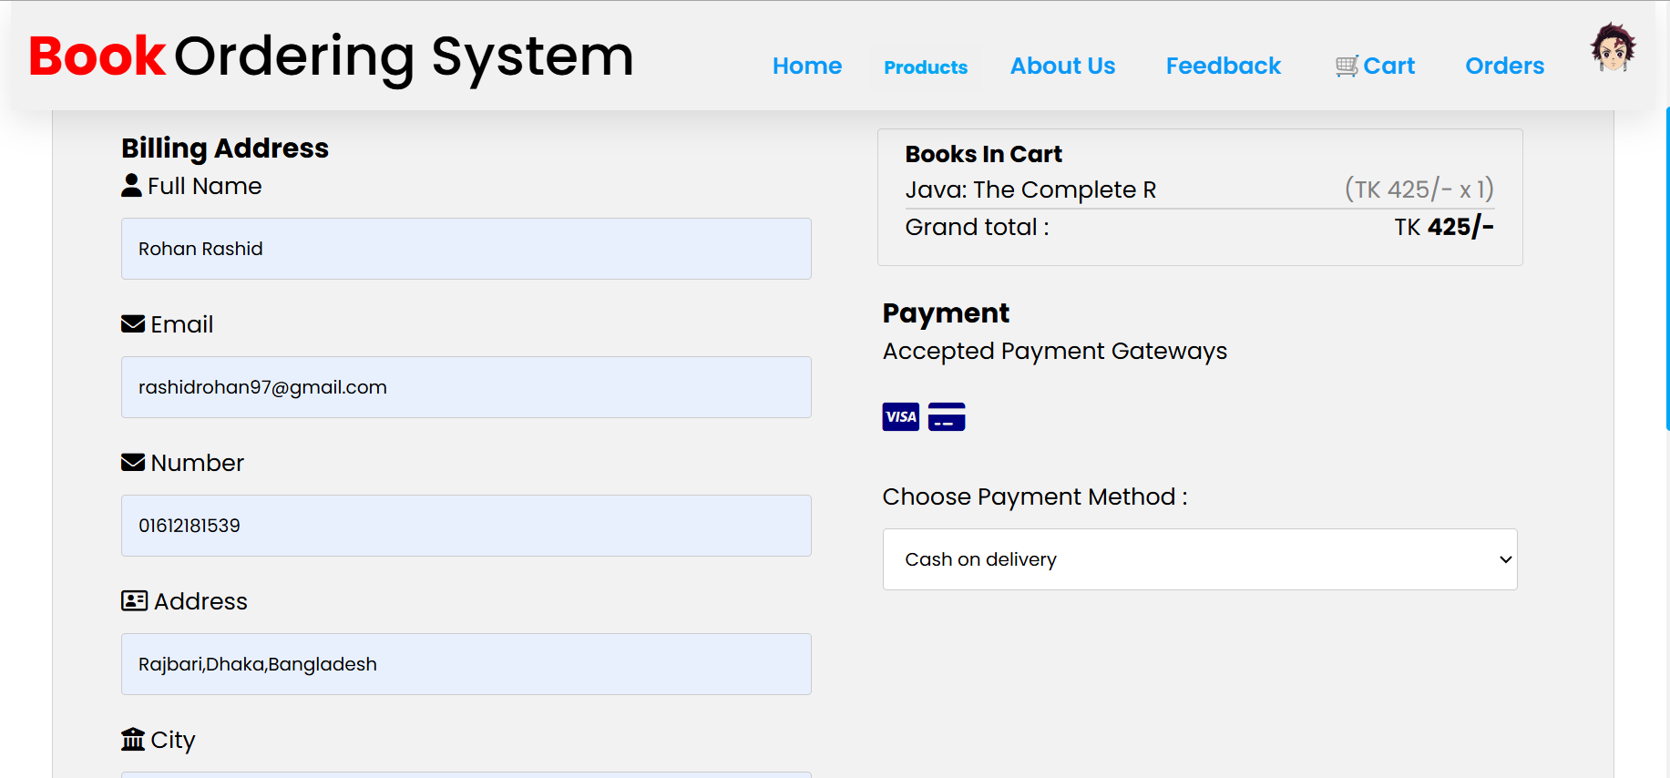
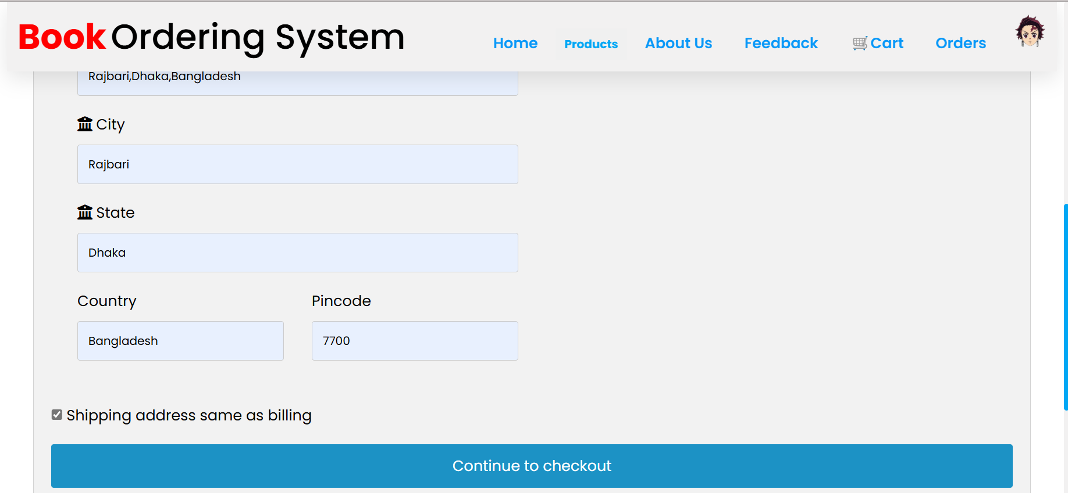
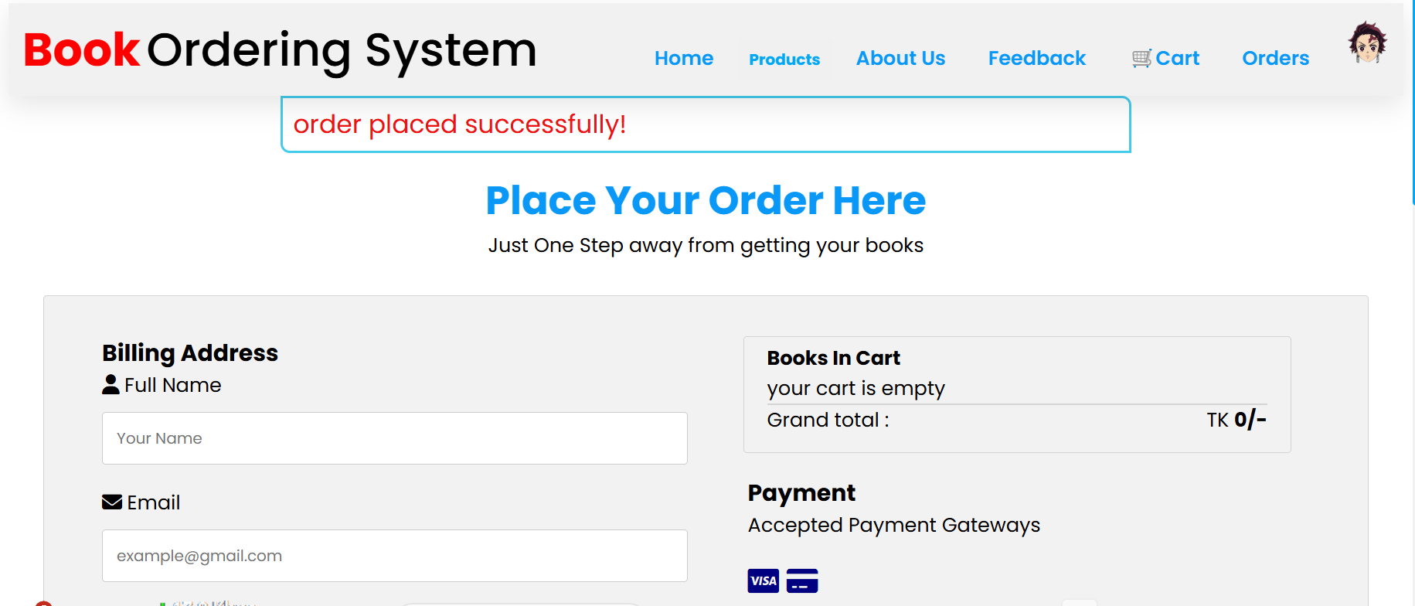
System Architecture
Order Module: Order processing and tracking.
Order Processing with Delivery Address

Slide 12
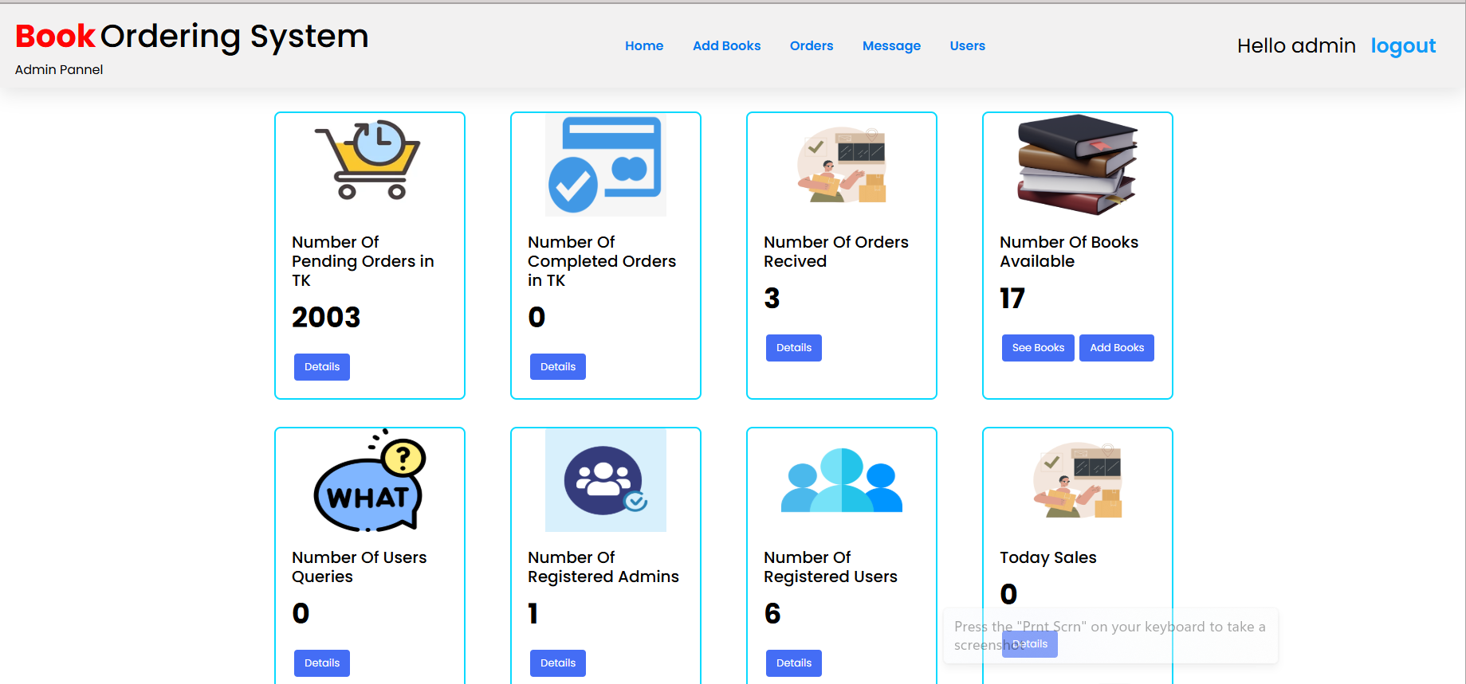
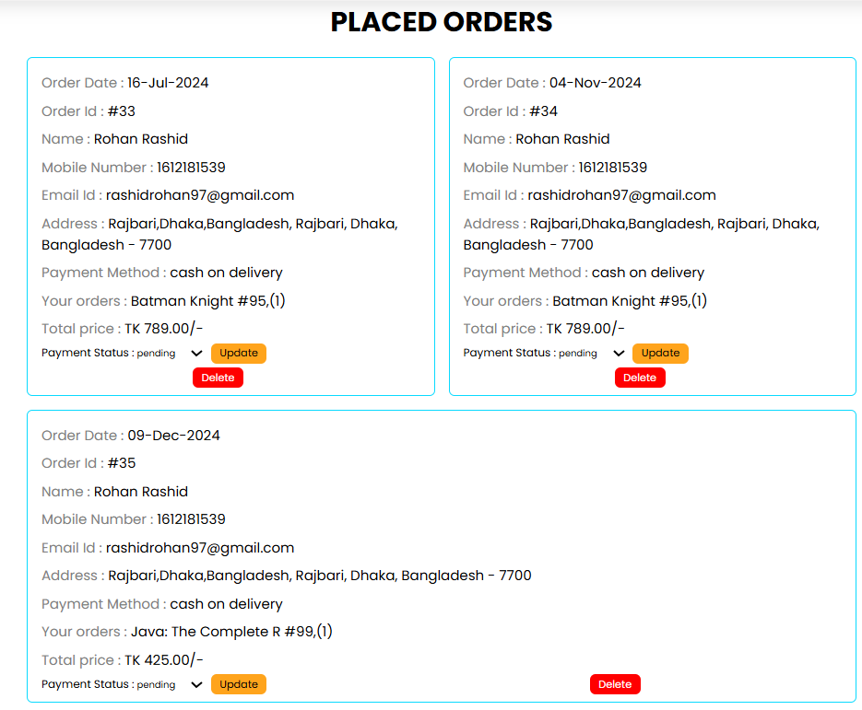
System Architecture
Admin Module: Inventory management and order supervision.

Slide 13
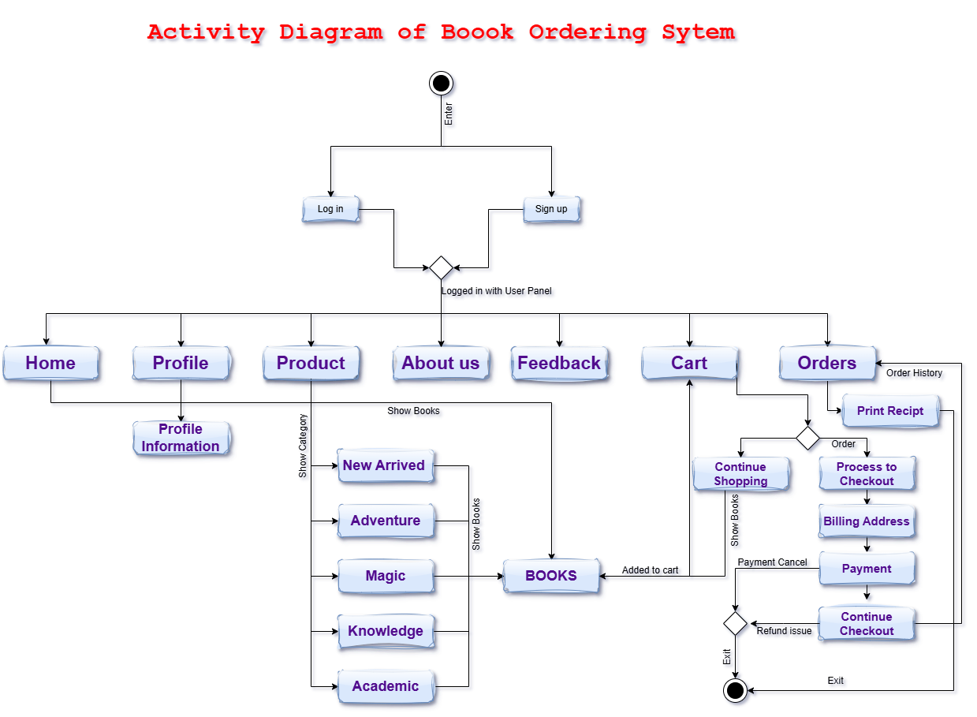
System Architecture
Flow of Data: :Showing a activity diagram of how data flows between modules.

Slide 14
Functional Features
For Customers:
Account creation, search functionality, order management.
For Administrators:
Add/remove books, manage inventory, track orders.
Cross-Platform Compatibility:
Works on desktops, laptops, and mobile devices.

Slide 15
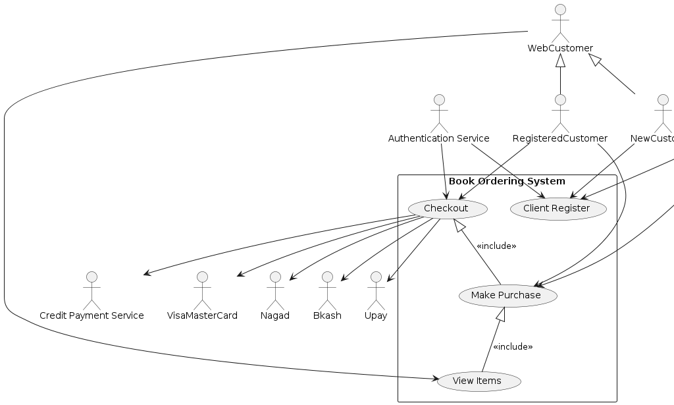
System Design
Use Case Diagram:
Show interaction between users, administrators, and the system.

Slide 16
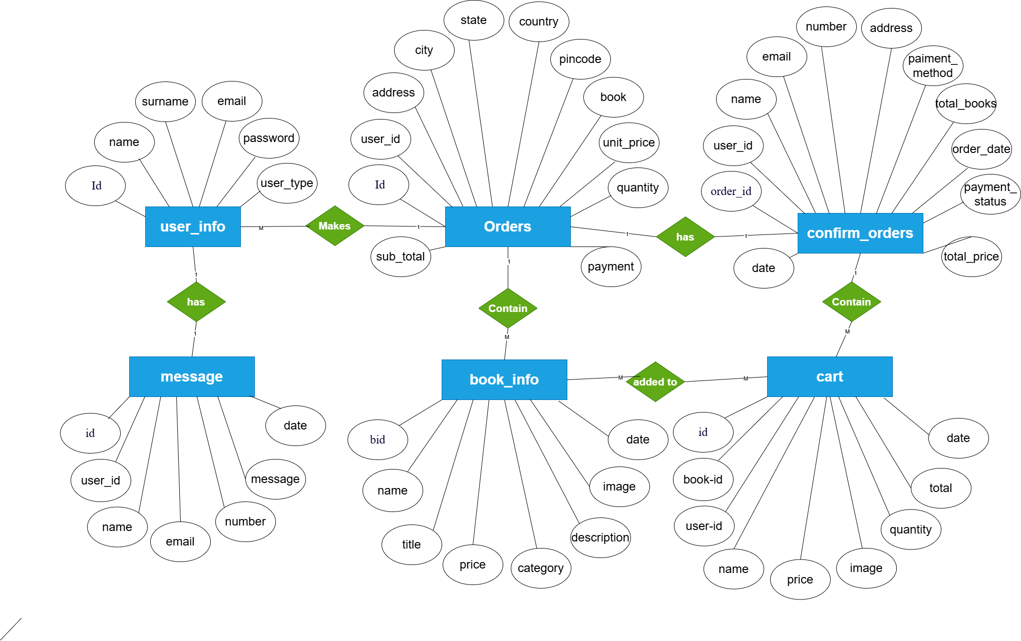
System Design
ER Diagram:
Highlight relationships between key entities like Users, Books, and Orders.

Slide 17
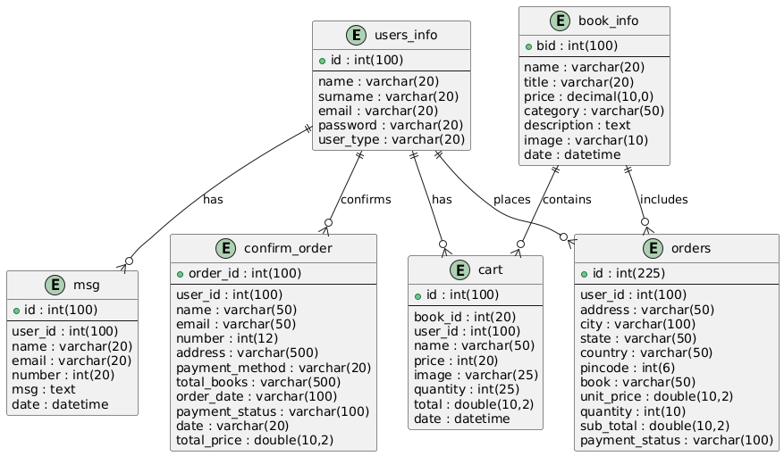
System Design
Database Tables:
Highlight table structure for Users, Books, and Orders.

Slide 18
Observations and Limitations
Observations:
Streamlined book ordering process.
User-friendly interface with accurate order tracking.
Limitations:
No payment gateway integration in the current version.
Requires an internet connection to operate.

Slide 19
Future Enhancements
Add real-time payment gateway integration.
Implement a recommendation system for users.
Develop a mobile app for better accessibility.

Slide 20
Conclusion
Summary:
The Book Ordering System effectively addresses the challenges of traditional systems.
Takeaway:
Provides a scalable, user-friendly solution for online book purchasing and management.

Slide 21
References
Bootstrap Documentation: https://getbootstrap.com
MySQL Documentation: https://dev.mysql.com/doc
Apache HTTP Server: https://httpd.apache.org
PHP Documentation: https://www.php.net/docs.php
CSS Specifications: https://www.w3.org/Style/CSS

Slide 22
thank you
👤 Rohan RASHID
📞 01612181539
📧 21222203050@cse.bubt.edu.bd

